Slide 1
Optimizing Orderpicking Routes
with Machine learning

Slide 2
What most people think:

Slide 3
What most people think:

Slide 4
What most people think:

Slide 5
Real life:

Slide 6
Real life:

Slide 7
Real life:

Slide 8
Some numbers:
Around 65% of the costs made in a manual operated warehouse are spend on order picking labor costs.

Slide 9
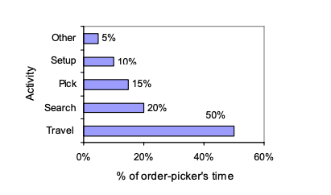
Some numbers:
Around 65% of the costs made in a manual operated warehouse are spend on order picking labor costs.

Slide 10
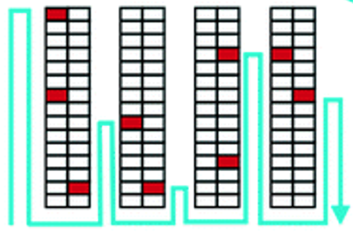
Return strategy:

Slide 11
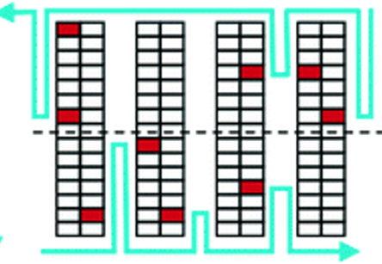
Return strategy:
Midpoint strategy:

Slide 12
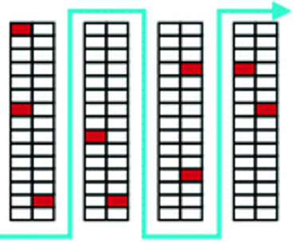
Return strategy:
Midpoint strategy:
S-shape strategy:

Slide 13
Some numbers about my data:
40.000 pallets outbound in first six months 2020 (actually low because of Corona)
Over 750 different items
Around half of the items are with expiracy date
Around 1250 dynamic pick locations
Operation runs 16 hours a day / 5 days a week
Around 40 people in a shift

Slide 14
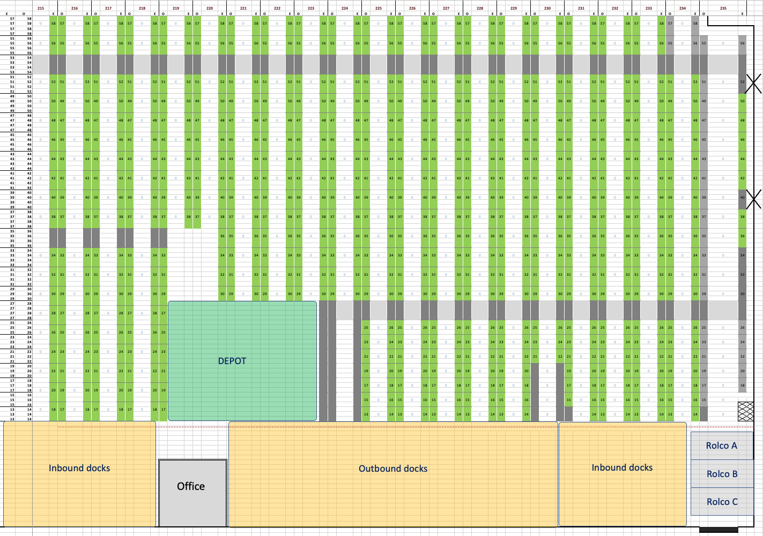

Slide 15
Reinforcement Learning

Slide 16
Reinforcement Learning Q learning

Slide 17
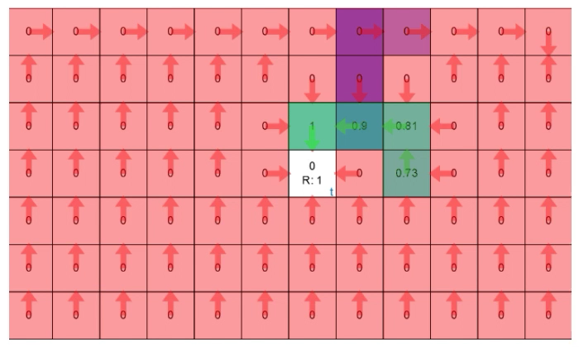
Reinforcement Learning Q learning

Slide 18
My setup:

Slide 19
Order picking routing:

Slide 20
Current way of working (S-shape) (3 locations):
Distance:
42 steps

Slide 21
Current way of working (S-shape) (3 locations):
Experienced picker
Distance:
32 steps

Slide 22
Small demonstration
via PY file

Slide 23
Route with Q learning (3 locations):
OUTPUT Reinforcement model:
The shortest route is:
['Depot', 'A.a', 'A.10.1', 'A.10.2', 'A.10.3', 'A.10.4', 'A.c', 'B.d', 'B.13.1', 'B.12.1', 'B.c', 'C.d', 'C.c', 'C.12.1', 'C.12.2', 'C.12.3', 'C.12.2', 'C.12.1', 'C.c', 'C.10.4', 'C.10.3', 'C.10.2', 'C.10.1', 'C.a', 'Depot’]
Processing time: 25 sec
Distance:
24 steps
42% less
25% less
(compared to experienced picker)

Slide 24
Current way of working (S-shape) (4 locations):
Distance:
32 steps

Slide 25
Route with Q learning (4 locations):
OUTPUT Reinforcement model:
The shortest route is:
['Depot', 'A.a', 'A.10.1', 'A.10.2', 'A.10.3', 'A.10.4', 'A.c', 'B.d', 'B.13.1', 'B.d', 'A.c', 'A.12.1', 'A.12.2', 'A.12.3', 'A.12.4', 'A.e', 'B.f', 'B.e', 'C.f', 'C.e', 'C.12.4', 'C.12.3', 'C.12.2', 'C.12.1', 'C.c', 'C.10.4', 'C.10.3', 'C.10.2', 'C.10.1', 'C.a', 'Depot’]
Processing time: 2 min 7 sec
Distance:
30 steps
6% less!

Slide 26
Current way of working (S-shape) (5 locations)
Distance:
42 steps

Slide 27
Route with Q learning (5 locations):
OUTPUT Reinforcement model:
The shortest route is:
['Depot', 'A.a', 'A.10.1', 'A.10.2', 'A.10.3', 'A.10.4', 'A.c', 'A.12.1', 'A.12.2', 'A.12.3', 'A.12.2', 'A.12.1', 'A.c', 'B.d', 'B.13.1', 'B.d', 'B.c', 'C.d', 'C.13.1', 'C.13.2', 'C.13.3', 'C.12.3', 'C.12.2', 'C.12.1', 'C.c', 'C.d', 'B.c', 'B.10.4', 'B.10.3', 'B.10.2', 'B.10.1', 'B.a', 'Depot’]
Processing time: 10 min
Distance:
32 steps
23% less!

Slide 28
Drawbacks:
The model will “explode” quite quickly.
Number of possible routes and with that optimizations grows exponentially because order does matter!
Loc 1
Loc 2
Depot
Depot
Loc 2
Loc 1
Two locations to pick from give two possible routes (from depot to depot) and six parts of the route to optimize (every arrow).

Slide 29
Drawbacks:
The model will “explode” quite quickly.
Number of possible routes and with that optimizations grows exponentially because order does matter!
Loc 1
Loc 2
Loc 3
Loc 1
Loc 3
Loc 2
Loc 2
Loc 1
Loc 3
Depot
Depot
Loc 2
Loc 3
Loc 1
Loc 3
Loc 1
Loc 2
Loc 3
Loc 2
Loc 1
Three locations to pick from gives already six possible routes (from depot to depot) and 24 parts of the route to optimize (every arrow).

Slide 30
Drawbacks:
The model will “explode” quite quickly.
Number of possible routes and with that optimizations grows exponentially because order does matter!
Locations to visit | Possible routes | # optimizations
1 | 1 | 2
2 | 2 | 6
3 | 6 | 24
4 | 24 | 120
5 | 120 | 720
6 | 720 | 5 040
7 | 5 040 | 40 320
8 | 40 320 | 362 880
9 | 362 880 | 3 628 800
10 | 3 628 800 | 39 916 800
11 | 39 916 800 | 479 001 600
12 | 479 001 600 | 6 227 020 800
13 | 6 227 020 800 | 87 178 291 200
14 | 87 178 291 200 | 1 307 674 368 000
15 | 1 307 674 368 000 | 20 922 789 888 000

Slide 31
Drawbacks:
The model will “explode” quite quickly.
Number of possible routes and with that optimizations grows exponentially because order does matter!
Locations to visit | Measured processing time
1 | 2 sec
2 | 7 sec
3 | 25 sec
4 | 2 min and a bit
5 | Almost 10 minutes…

Slide 32
Next steps:
Explore possibilites of Deep Q Learning

Slide 33
Any questions?
The end

